Slide 1
Tavern Keeper Design
Silas Elder, Evan Primasing, Kaleb Scott, Kenneth Gray

Slide 2
Overview
Tavern Keeper is a web-based application that acts as a wiki of user data stored in a simple, clean user interface
Back end will be handled through the Vercel server infrastructure
The server will implement a PostgreSQL database for data storage
Front end will be utilize React and its built-in libraries
Front end to back end communication format will use JSON
Sign In Authentication will use Google API

Slide 3
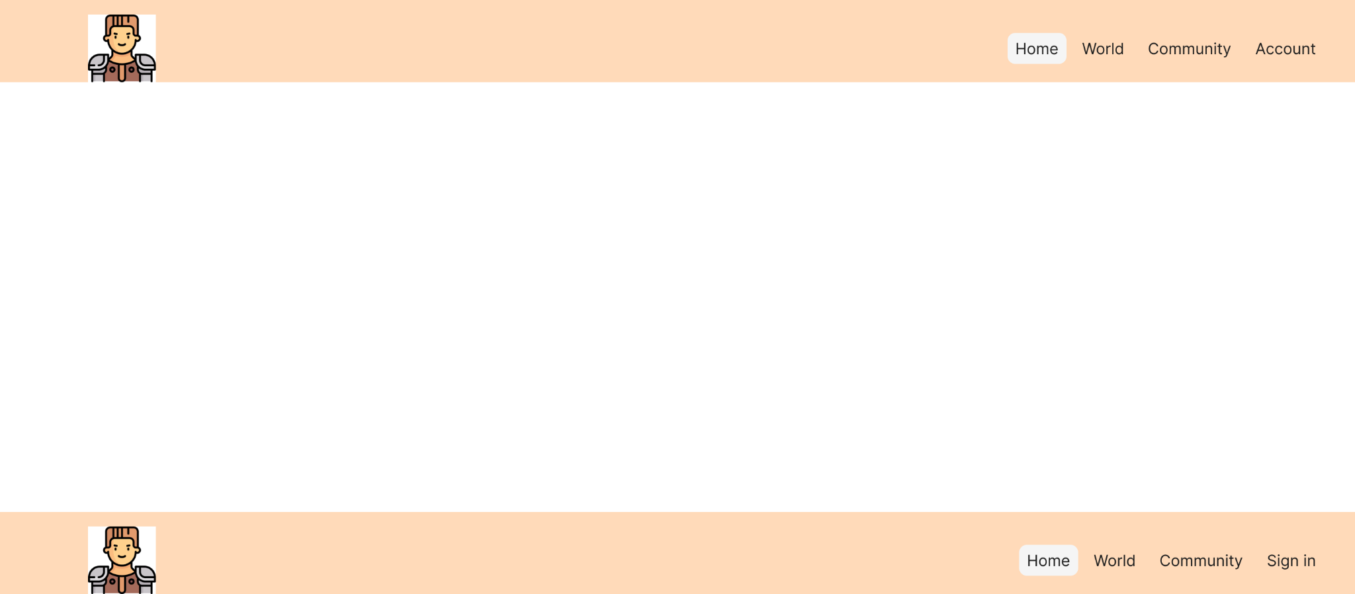
Header
On every page
Way to route through the website
Will automatically change when user is signed in

Slide 4
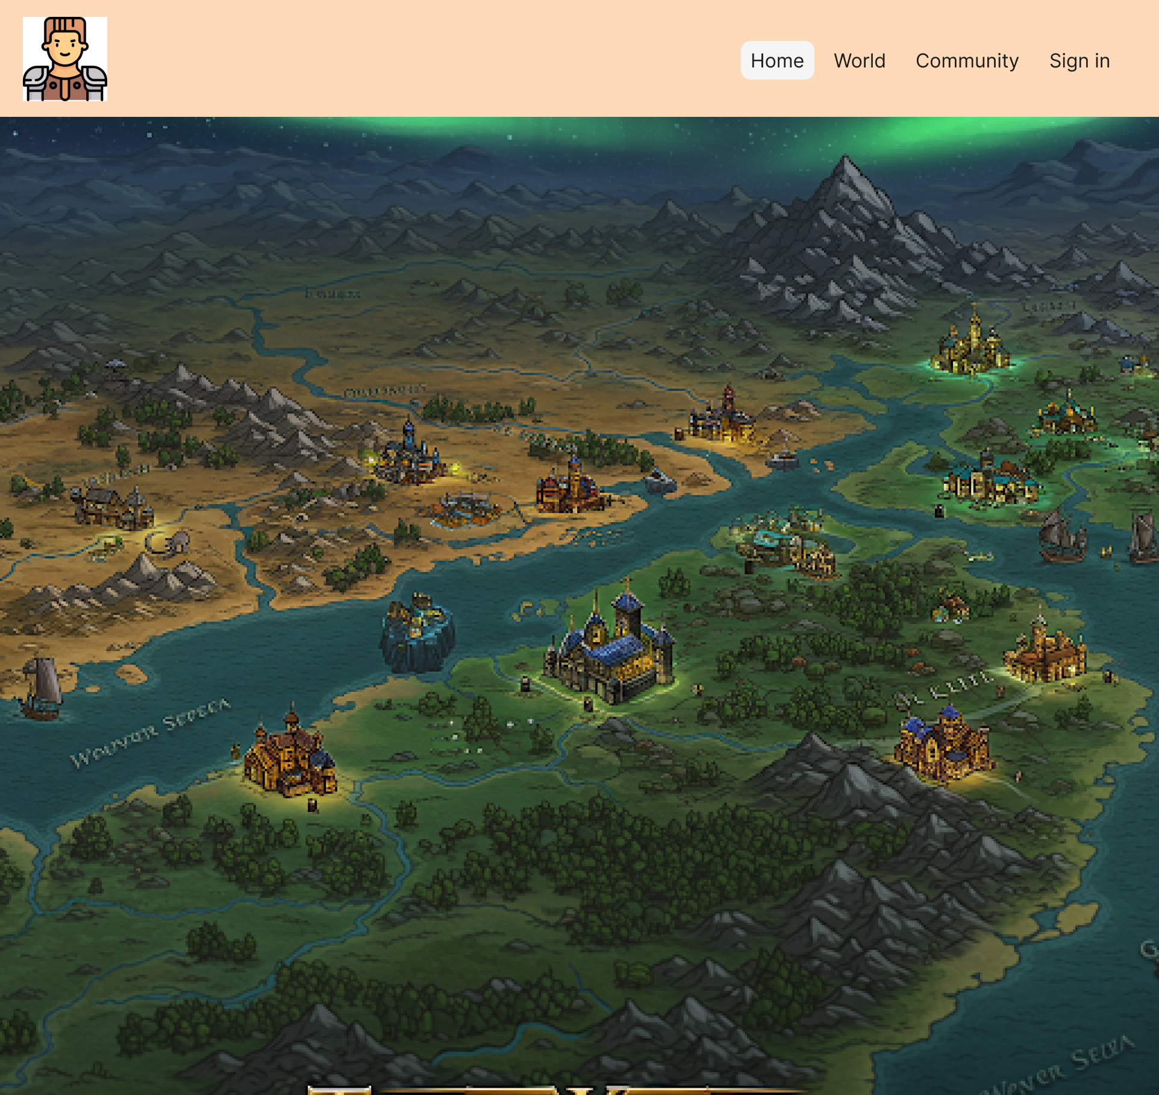
Home Page
Automatically loaded when the website is first pulled up

Slide 5
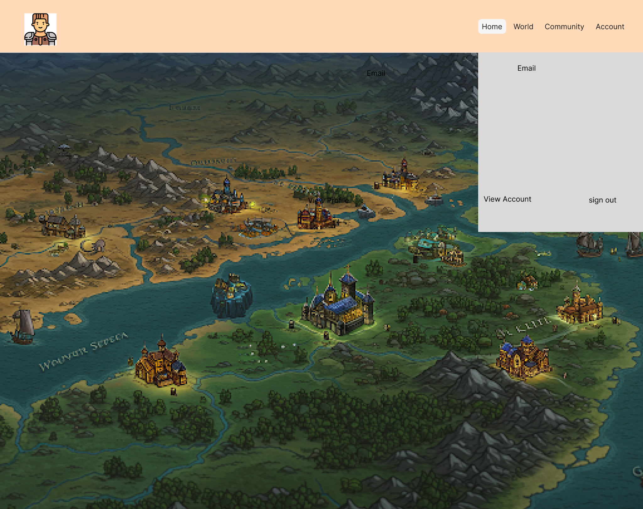
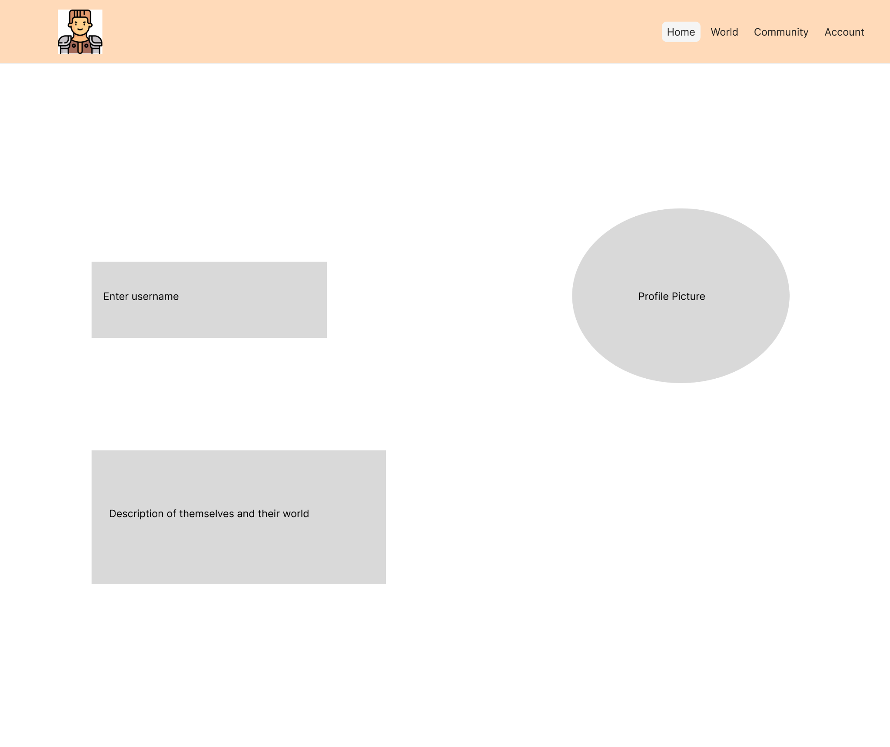
Account Drop down/page
When a user is signed in they will be able to view their account and sign out

Slide 6
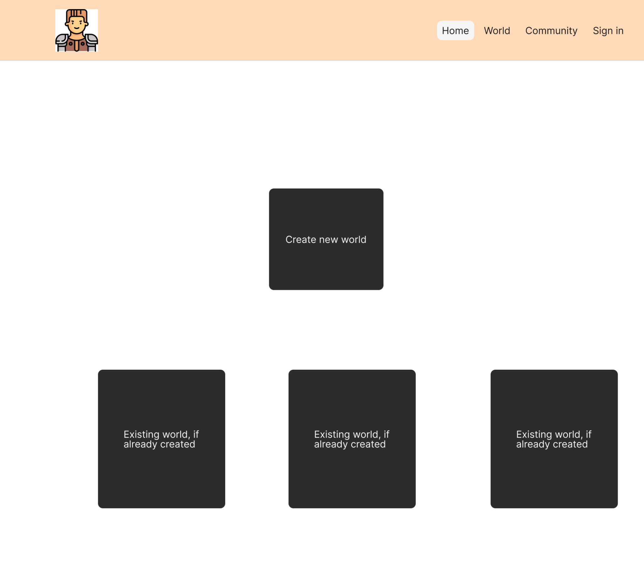
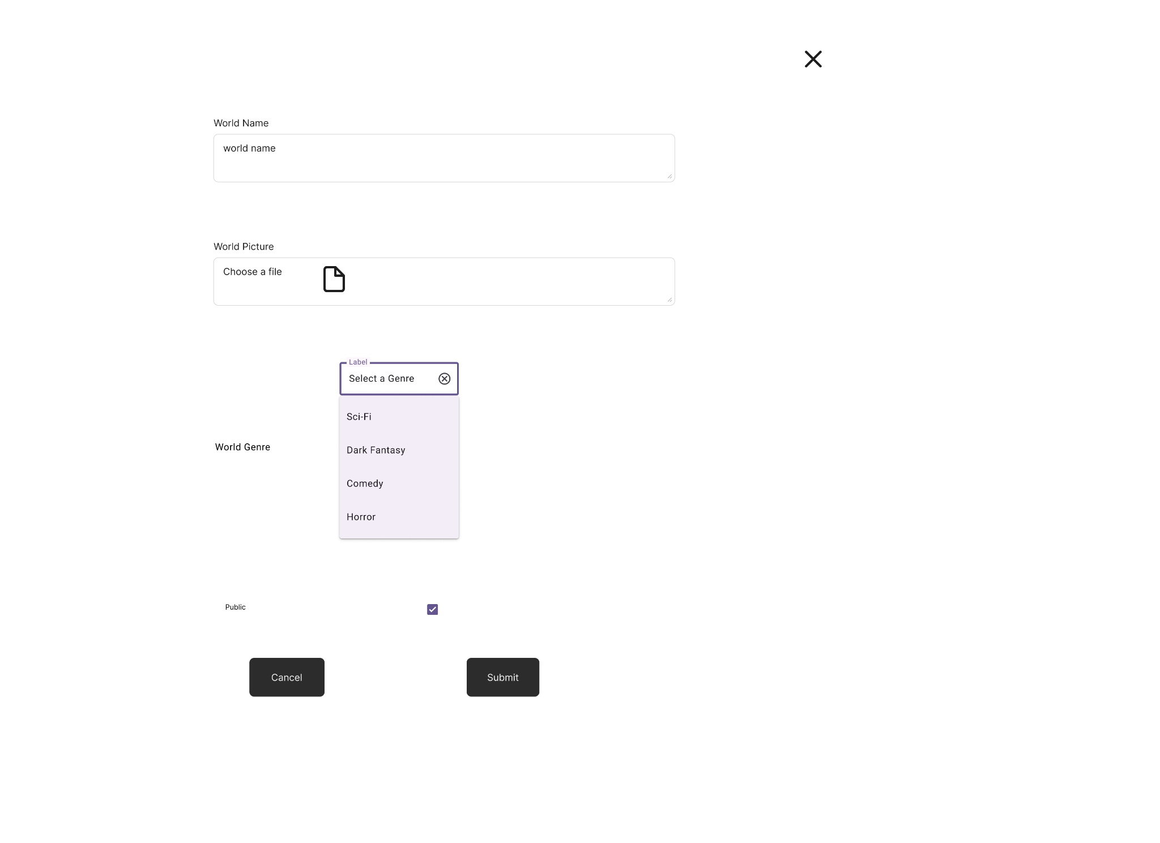
World Page
Will automatically display any previous worlds the user has created

Slide 7
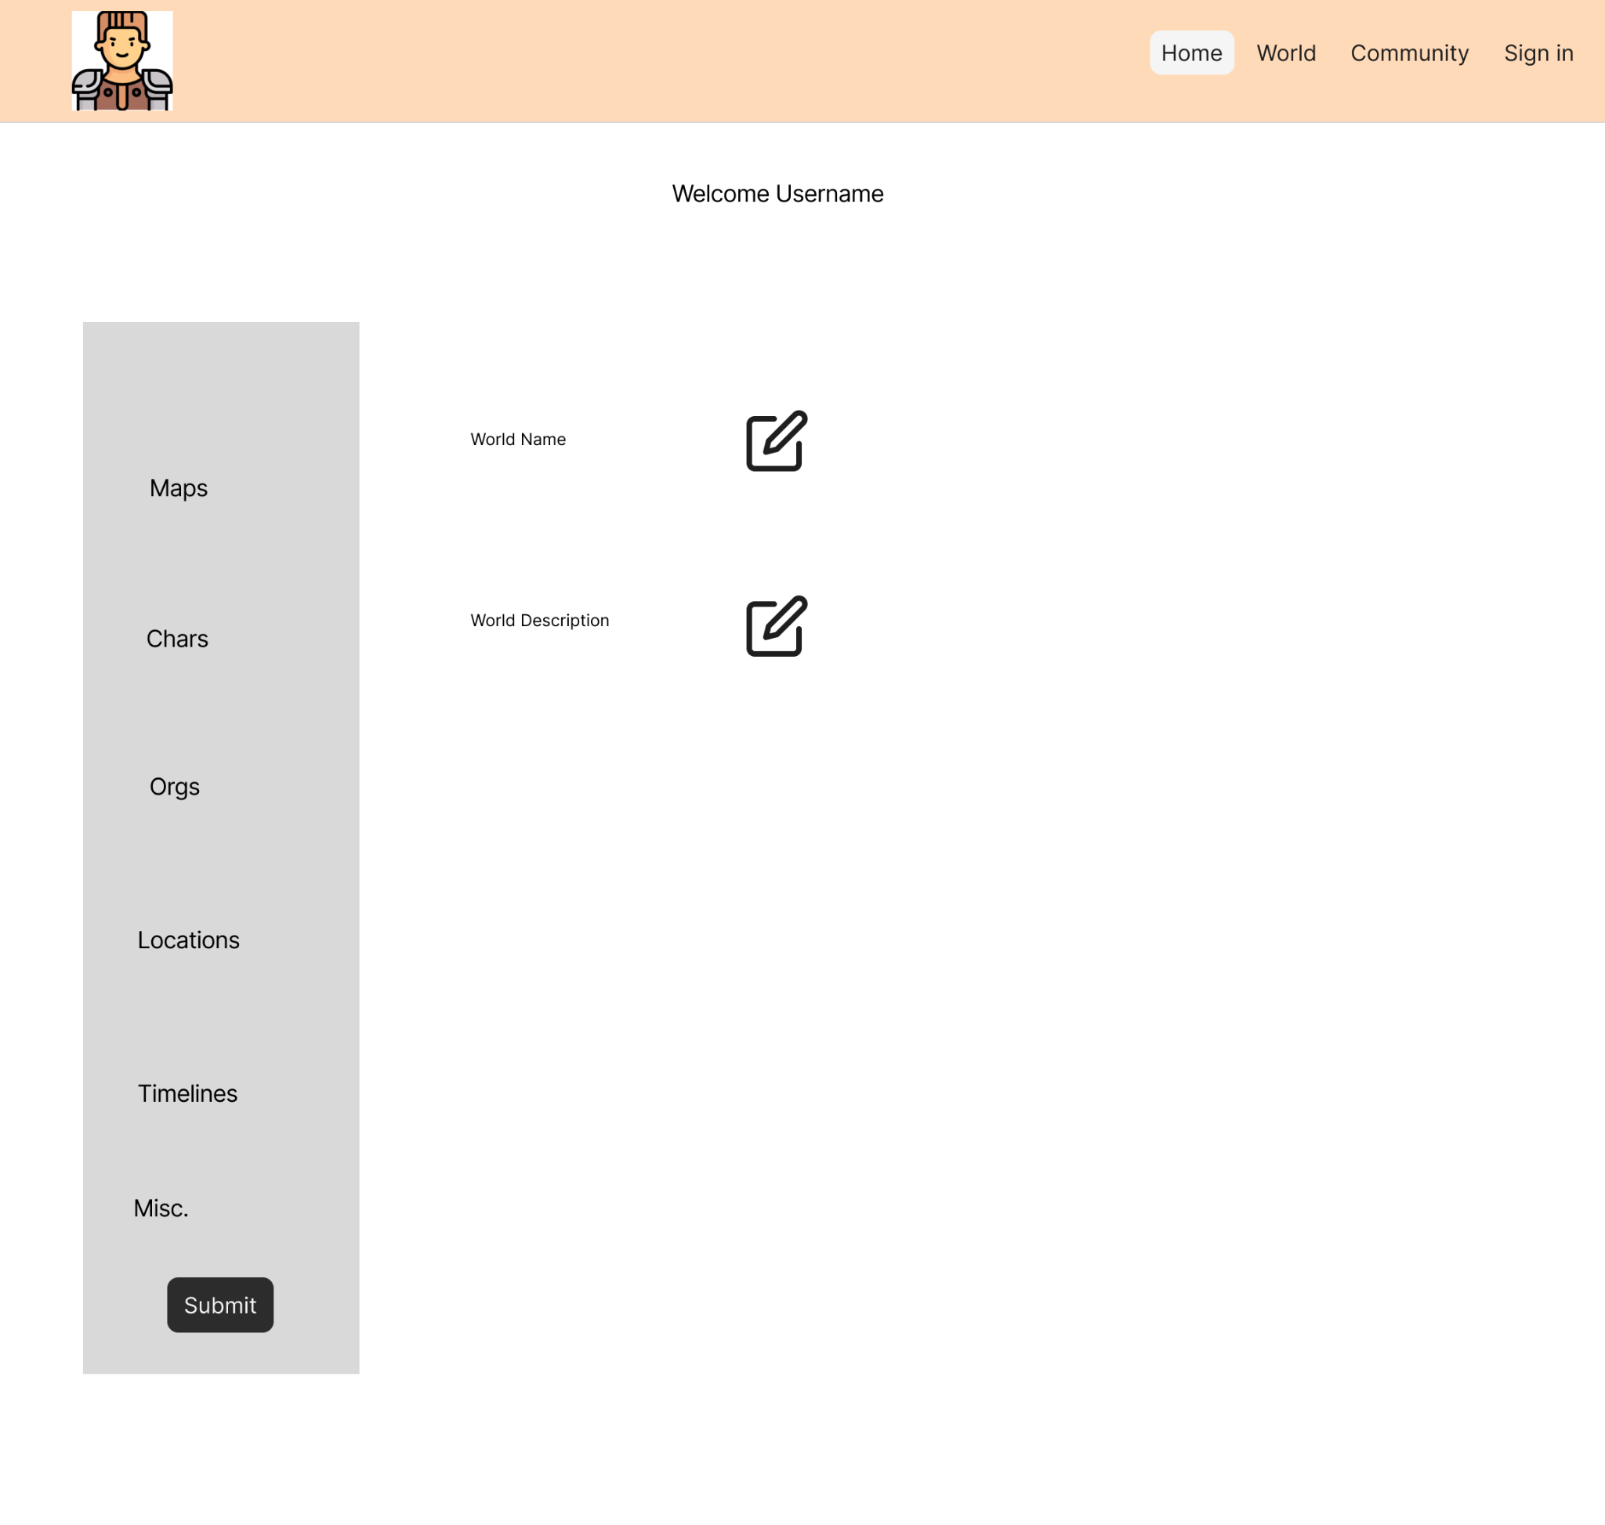
World Overview page
After clicking on world from the world page it will send you to this page.

Slide 8
Subpages
This is where we will utilize the grid display. This makes it easier to repetitively display similar data. This is where the majority of our data will be entered.

Slide 9
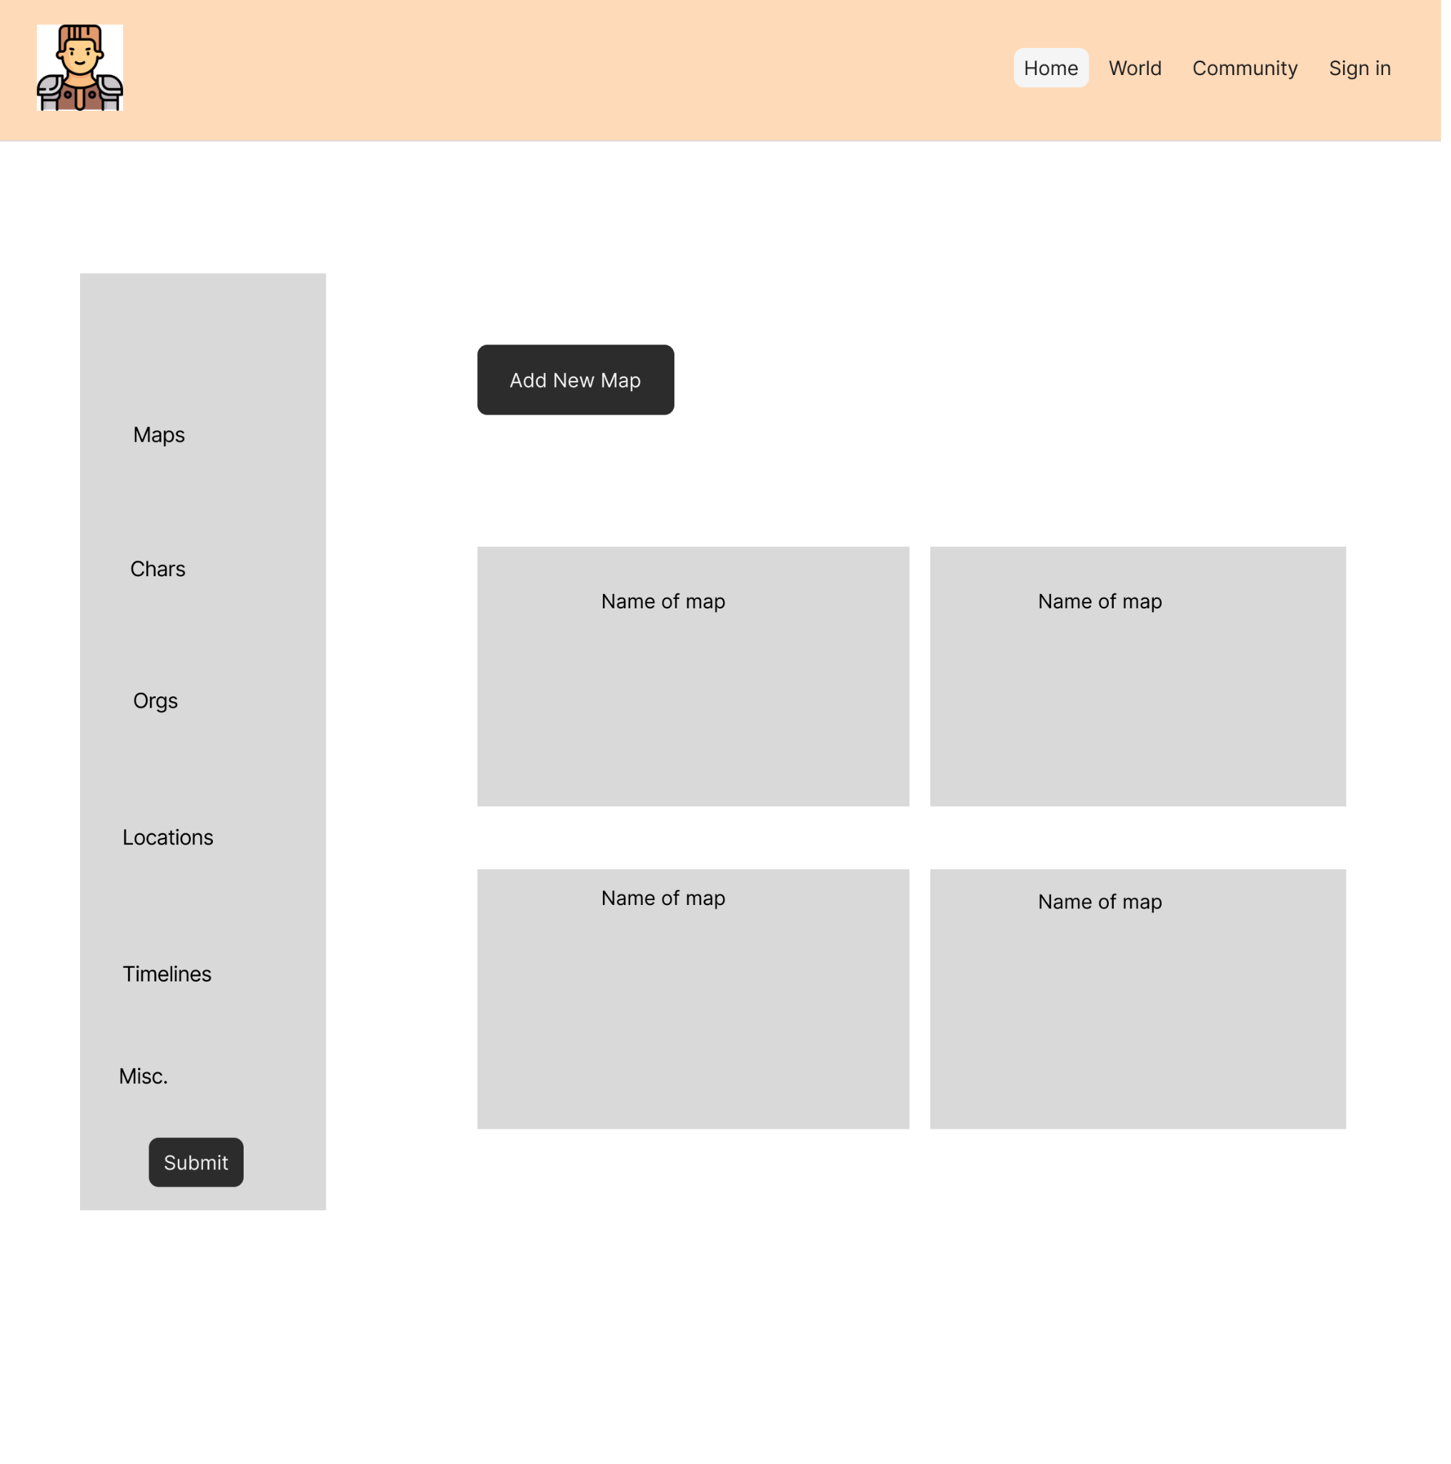
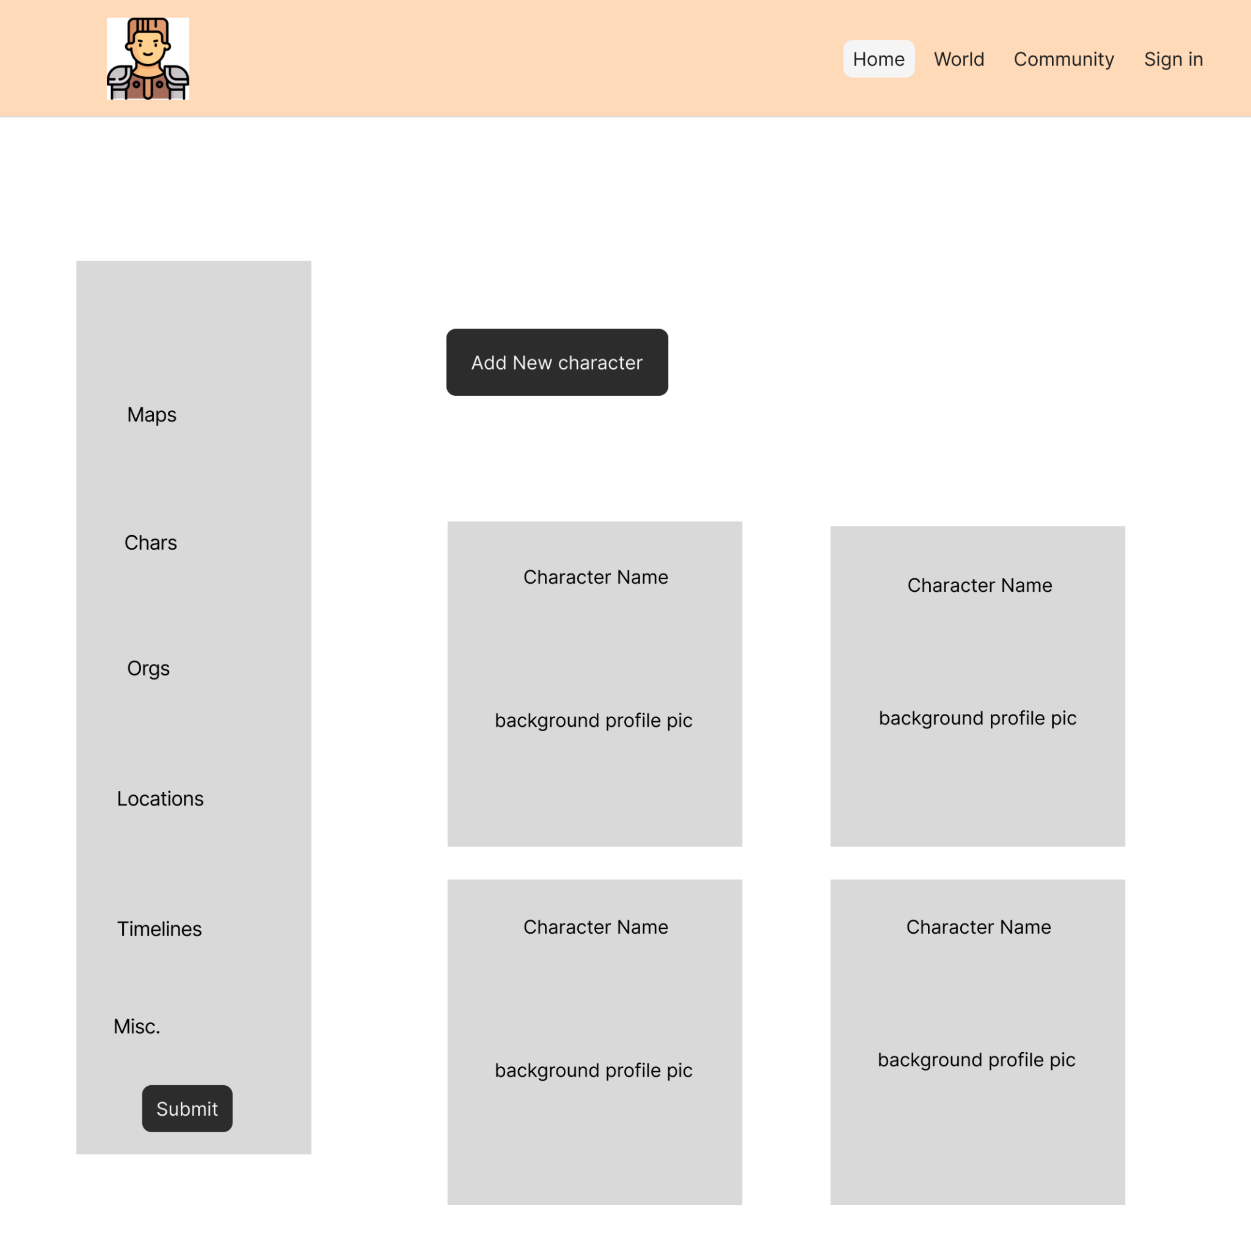
Subpages

Slide 10
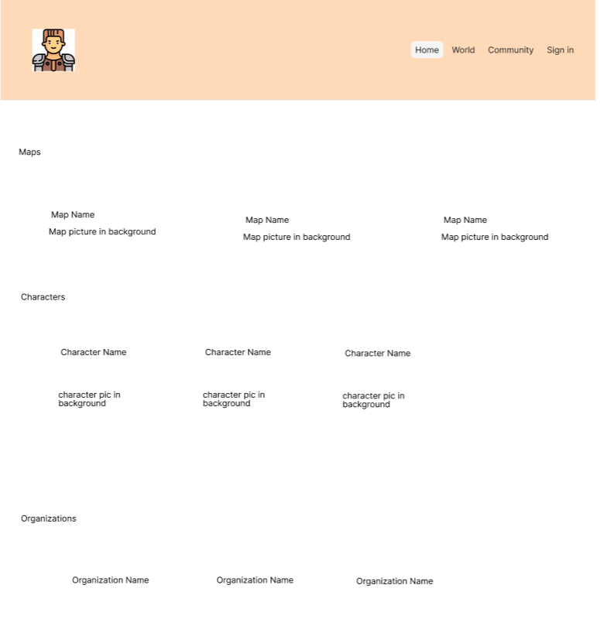
World Preview Page
This is where user’s will go to see all of their world data

Slide 11
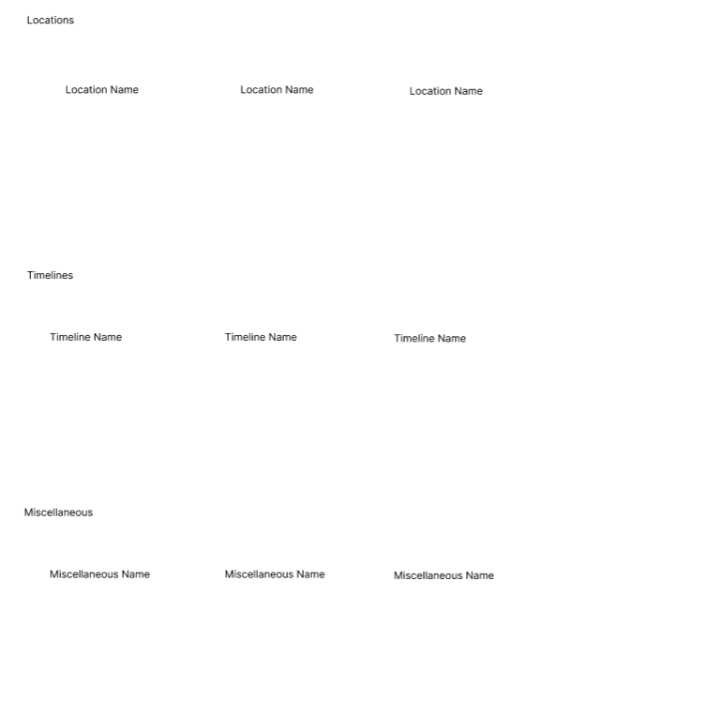
World Preview Page (cont.)

Slide 12
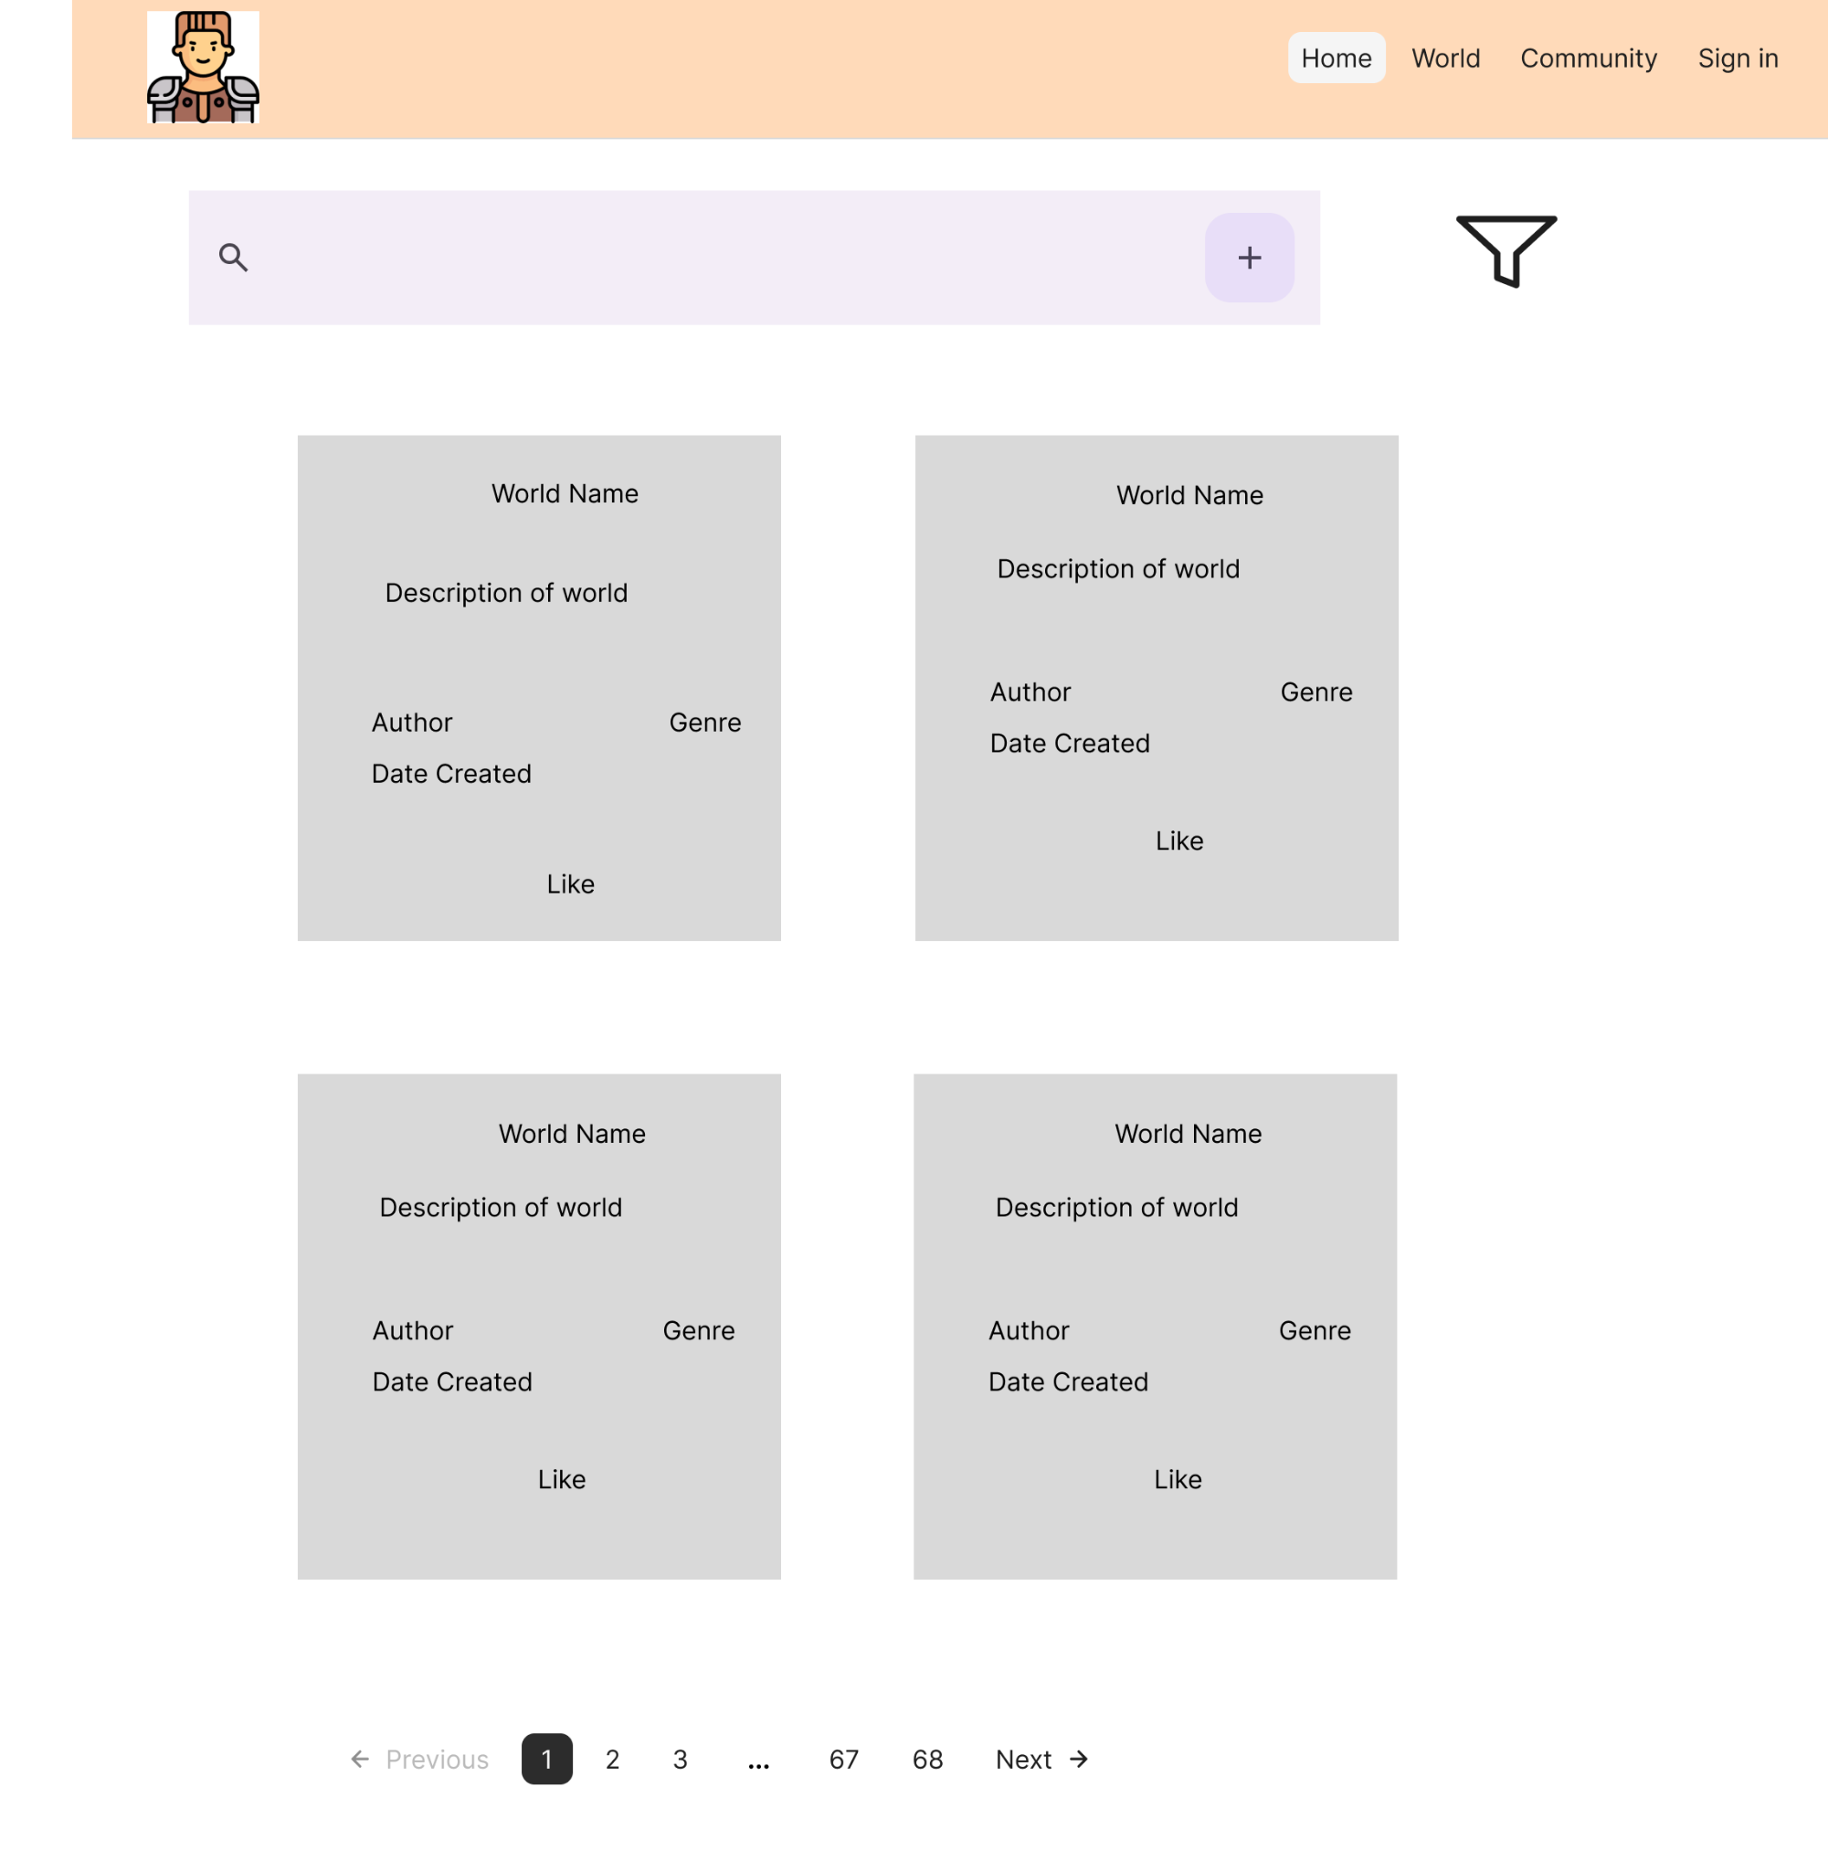
Community Page
Users will be able to search by world name and author name.
Users will be able to filter by genre.
Users will be able to navigate through many pages of worlds

Slide 13
Messaging
React easily allows you to pass data through JSON from the frontend to the backend.
Much of the message documentation will have very similar formats. This is how we will allow users to enter a world
{
"title": "string",
"description": "string",
"genre": "string",
"isPublic": "boolean",
"created": "Date",
"likes": "int",
"entries": [“Entries”]
}
This is what the response will be
{
"success": true,
"message": "World successfully added",
"worldID": w123,
}

Slide 14
Components & Classes
Main components/classes:
Login/Sign In
World
User
Entry
Entry subclasses

Slide 15
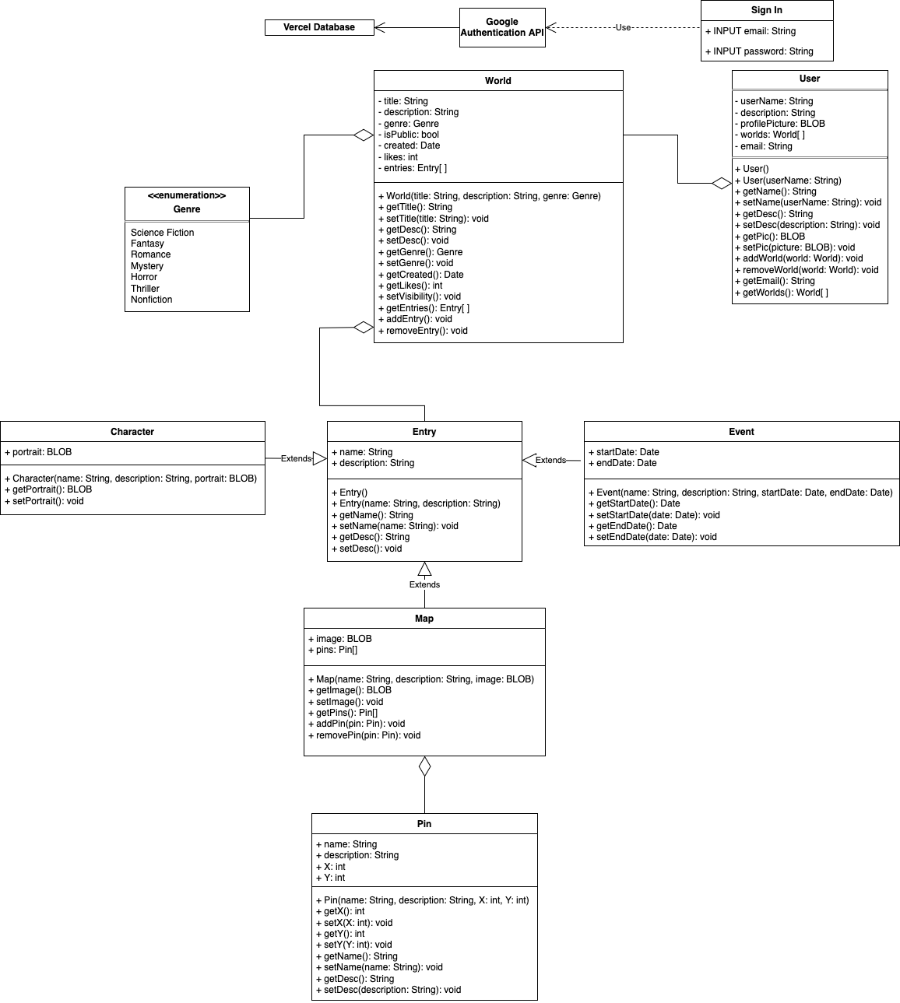
Components & Classes – Full Diagram

Slide 16
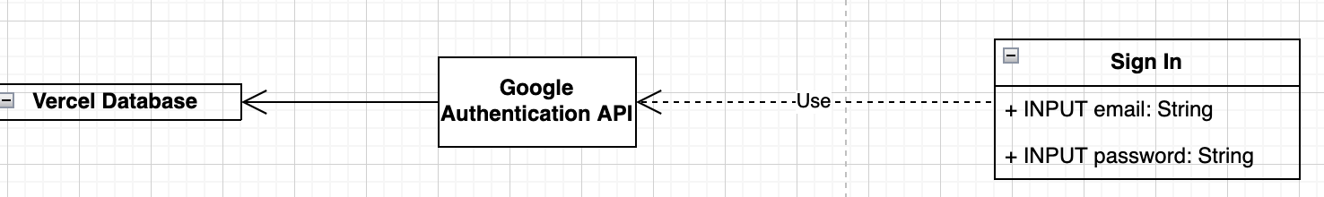
Components & Classes – Sign In
Tavern Keeper Sign In Form powered by Google API
Authentication & Security outsourced to Google
Email stored in Vercel Database
Used to make default username
Can be changed later

Slide 17
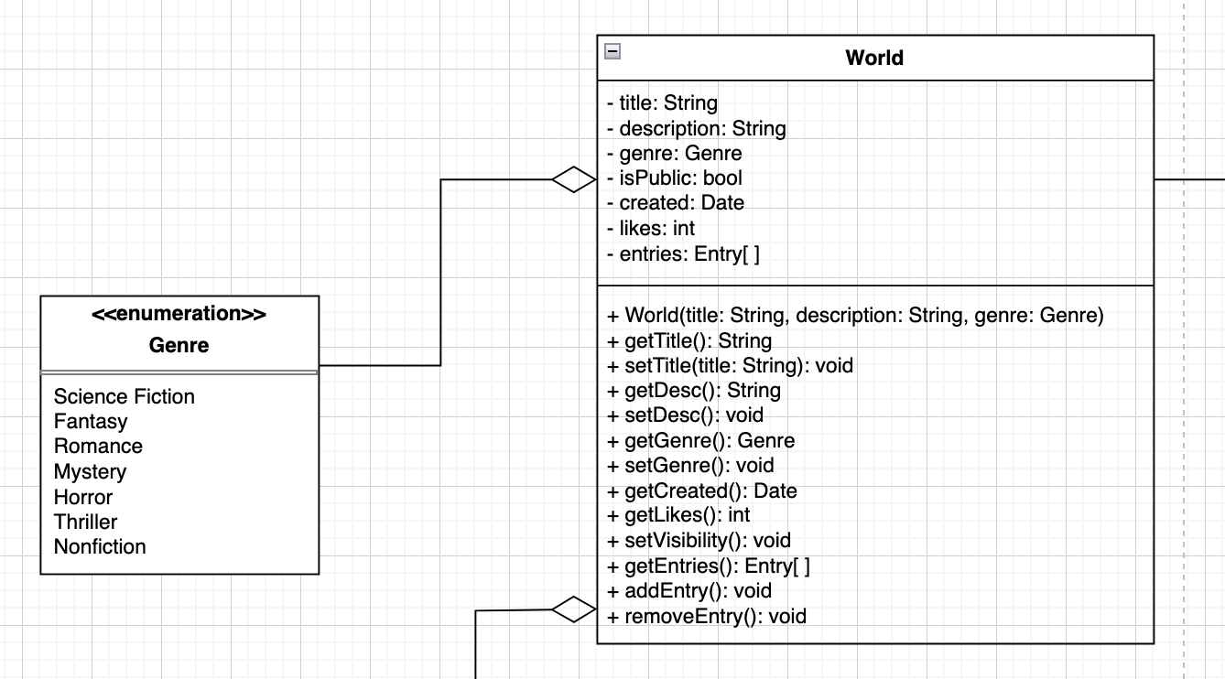
Components & Classes – World
Contains a list of entries
World Component manages entries associated with it
Methods update Worlds table in database
Genre enum - kept broad at our own discretion
Sorting

Slide 18
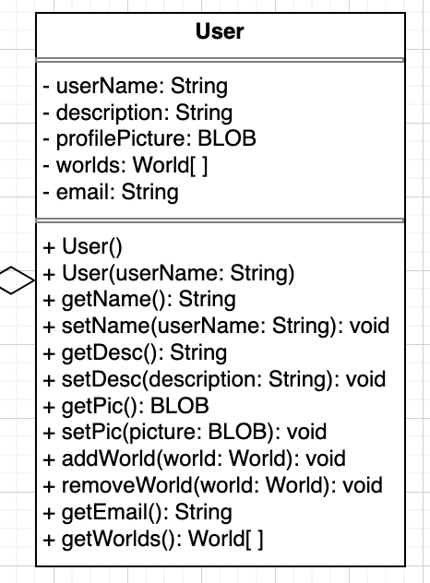
Components & Classes – User
Contains a list of worlds associated with user
Manages associated worlds
Methods make calls to Vercel database
Stores Gmail on sign in

Slide 19
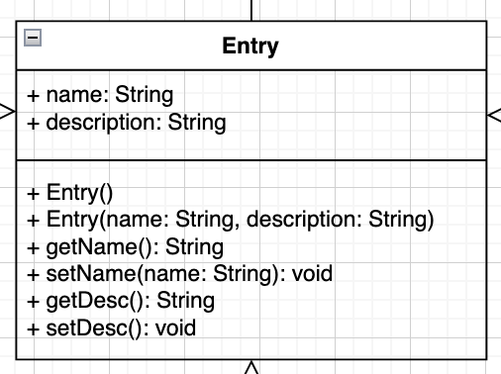
Components & Classes – Entry
Most basic unit of user input in class form
Organizations & Locations are entries only
Same fields so no separate class needed
Methods call Entry tables in database

Slide 20
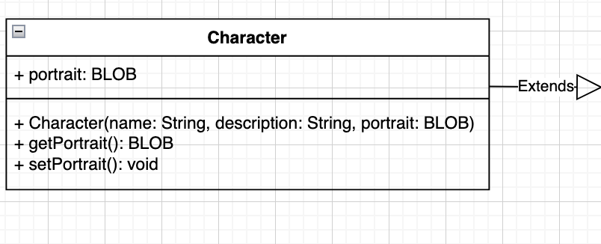
Components & Classes – Character
Subclass of entry
Implemented the same as an entry
Contains an extra field: portrait
Character Class will be responsible for updating and selecting character portraits stored in backend

Slide 21
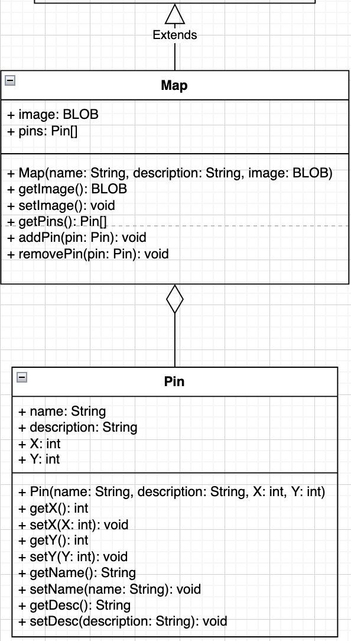
Components & Classes – Map + Pin
Map is another subclass of entry
Contains extra fields: image and pins
Image - uploaded picture of the map
Pins - list of pin objects associated with respective map
Pin object is a name, description, and location on a particular map

Slide 22
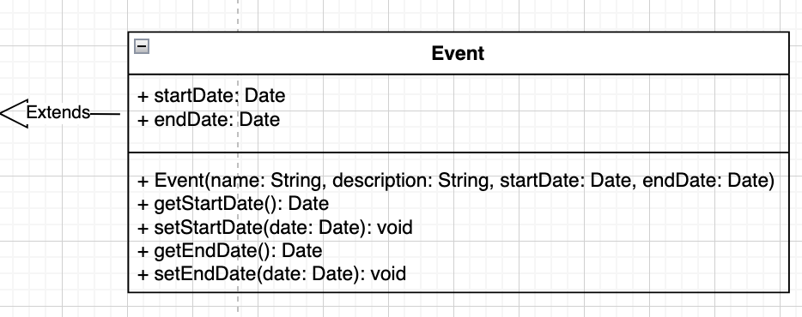
Components & Classes – Event
Subclass of entry
Contains added fields: startDate and endDate
Used to configure chronology of events
Sorted on front end timeline

Slide 23
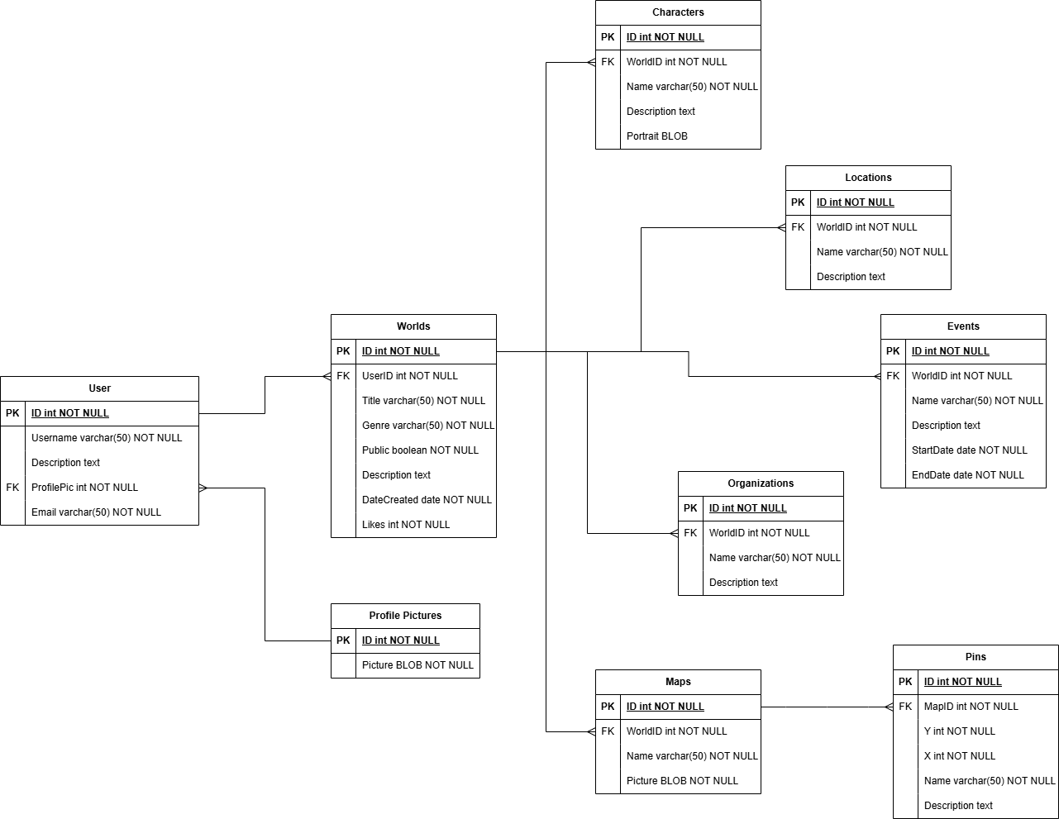
ERD
Hierarchy-based structure

Slide 24
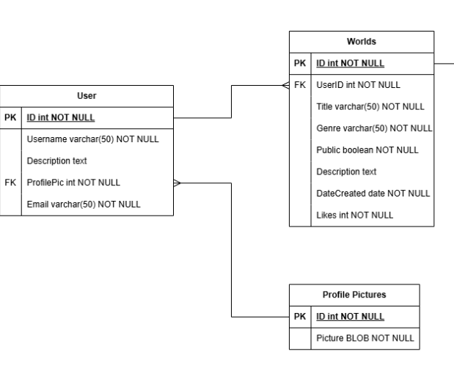
Central Tables
Used to access most other tables
Contains most basic information about worlds and users

Slide 25
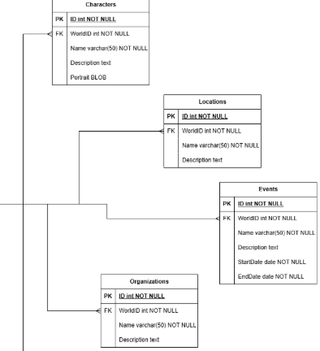
Entry tables
Lowest level of hierarchy
Stores basic information contained in a world
Directly connected to ID in world table

Slide 26
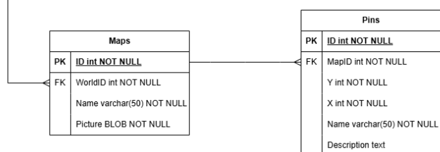
Map and Pins
Same levels as entries
Directly connected to ID in world table
Contains information for maps and location pins

Slide 27
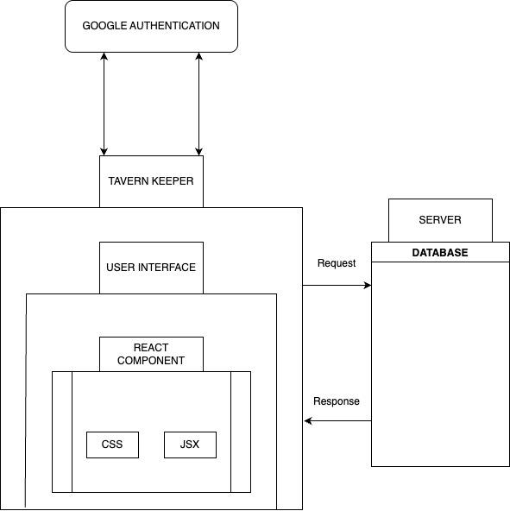
Block Diagram

Slide 28
Block Diagram
The system is a web-based application that integrates components for its functionality.
Key features:
User Authentication via Google Authentication.
A React-based UI
A backend vercel server to process requests and connects to a database for data storage and retrieval.

Slide 29
Block Diagram - Component Breakdown
Google Authentication - Handles user login and authentication.
Tavern Keeper - Manages authentication flow and user sessions.
User Interface - The frontend where users interact with the whole system. (Built with JSX for structure, CSS for styling)
Server - Processes requests from the UI and interacts with database.
Database - Stores user and application data, providing responses to the server which then is sent to the UI.

Slide 30
Recap
Our project, Tavern Keeper, will allow users to create worlds, maps, characters, and store other information about their world.
We will send our data from the frontend to the backend and into the database through the format we outlined in the message documentation.
We will store the data in our database through the structure outlined in our ERD Diagram.

Slide 31
Questions
Thank you all for listening!
Are there any questions?

